Slide 1

Unit - II
Building Blocks and Databases

Slide 2
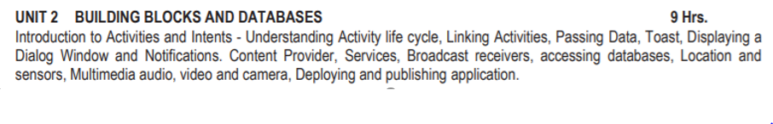

Slide 3
Unit- II - Building Blocks and Databases
1. Introduction to Activity and Intents
2. Understanding Activity Life Cycle
3. Linking Activities
4. Passing Data
5. Toast
6. Displaying Dialog Window
7. Notifications
8. Services
9. Broadcast Receivers
10. Content Provider
11. SQLite – Database
12. Publish App in Playstore
13. Sample Applications
3

Slide 4
1. Introduction to Activity and Intents
An Activity is an application component that provides a screen with which users can interact in order to do something, such as dial the phone, take a photo, send an email, or view a map.
Each activity is given a window in which to draw its user interface.
The window typically fills the screen, but may be smaller than the screen and float on top of other windows.
4

Slide 5
Introduction to Activity and Intents (con…)
Intents in android are used as message passing mechanism that works both within your application and between applications.
Three of the core components of an application — activities, services, and broadcast receivers are activated through messages, called intents
E.g. Intents can be used to start an activity to send email.

Slide 6
2. Android Activity Life Cycle
The steps that an application goes through from starting to finishing
Slightly different than normal Java life cycle due to :
The difference in the way Android application are defined
The limited resources of the Android hardware platform

Slide 7
Activity Life Cycle (con…)
Each application runs in its own process.
Each activity of an app is run in the apps process
Processes are started and stopped as needed to run an apps components.
Processes may be killed to reclaim needed resources.
Killed apps may be restored to their last state when requested by the user

Slide 8
Activity Life Cycle(con…)
Management of the life cycle is done automatically by the system via the activity stack.
The activity class has the following callbacks to help you manage the app:
onCreate()
onStart()
onResume()
onPause()
onStop()
onRestart()
onDestroy()
method

Slide 9
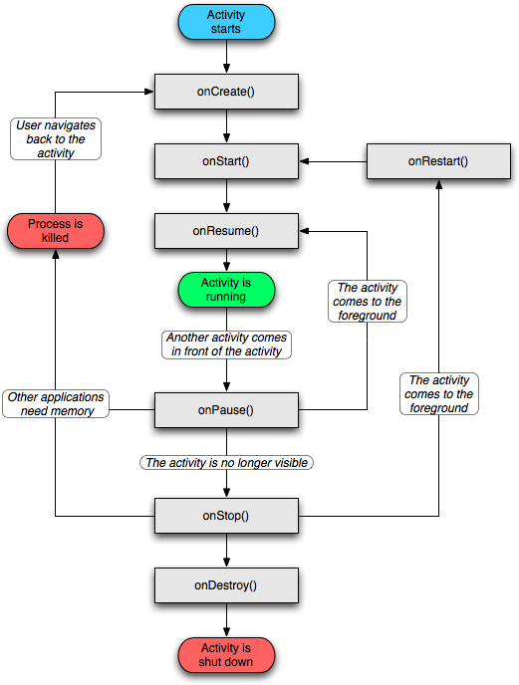
Activity Life Cycle

Slide 10
Example
public class MainActivity extends Activity { @Override
protected void onCreate(Bundle savedInstanceState) { super.onCreate(savedInstanceState); setContentView(R.layout.activity_main); Toast.makeText(getApplicationContext(), “I am onCreate() Method", Toast.LENGTH_SHORT).show();
}

Slide 11
Example (con…)
@Override
protected void onStart() { Toast.makeText(getApplicationContext(), “I am onStart() method", Toast.LENGTH_SHORT).show(); super.onStart();
}
@Override
protected void onResume() { Toast.makeText(getApplicationContext(), " I am onResume() method ", Toast.LENGTH_SHORT).show(); super.onResume();
}

Slide 12
Example (con…)
@Override
protected void onPause() { Toast.makeText(getApplicationContext(), " I am onPause() method ", Toast.LENGTH_SHORT).show(); super.onPause();
}
@Override
protected void onStop() { Toast.makeText(getApplicationContext(), " I am onStop() method ", Toast.LENGTH_SHORT).show(); super.onStop();
}

Slide 13
Example (con…)
@Override
protected void onRestart() { Toast.makeText(getApplicationContext(), " I am onRestart() method ", Toast.LENGTH_SHORT).show(); super.onRestart();
}
@Override
protected void onDestroy() { Toast.makeText(getApplicationContext(), " I am onDestroy() method ", Toast.LENGTH_SHORT).show(); super.onDestroy();
} }

Slide 14
3. Linking Activity
Android Intent is an abstract description of an operation to be performed.
It can be used with,
An startActivity() to launch an Activity
An sendBroadcast() to send it to any interested BroadcastReceiver components
An startService(Intent) to communicate with a background Service

Slide 15
Linking Activity (con…)
Intent Objects
An Intent object is a bundle of information which is used by the component that receives the intent.
Intent object can contain the following components
Action
A string naming the action to be performed.
The action in an Intent object can be set by the
setAction() method and read by getAction().
14

Slide 16
Linking Activity (con…)
Data
Adds a data specification to an intent filter.
The setData() method specifies data only as a URI, setType() specifies it only as a MIME type, and setDataAndType() specifies it as both a URI and a MIME type. The URI is read by getData() and the type by getType().

Slide 17
Linking Activity (con…)
Category
The category is an optional part of Intent object and it's a string containing additional information about the kind of component that should handle the intent.
The addCategory() method places a category in an Intent object, removeCategory() deletes a category previously added

Slide 18
Linking Activity (con…)
Extras
This will be in key-value pairs for additional information that should be delivered to the component handling the intent.
The extras can be set and read using the putExtras()
and getExtras() methods respectively.
Flags
The flags are optional part of Intent object
It helps to instruct the Android system how to launch an activity, and how to treat it after it's launched etc.

Slide 19
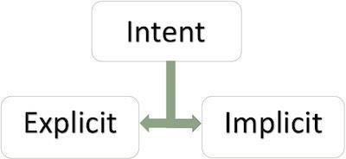
Linking Activity (con…)
Types of Intents
– There are following supported by Android
two types of intents

Slide 20
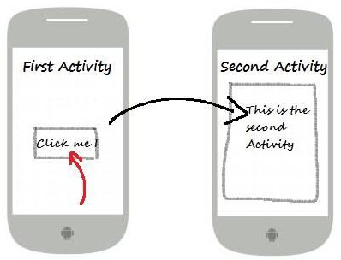
Linking Activity (con…)
Explicit Intents
– It going to be connected internal world of application, i.e. to connect one activity to another activity, below image is connecting first activity to second activity by clicking the button.

Slide 21
Linking Activity (con…)
Explicit intents explicitly define the component which should be called by the Android system, by using the Java class as identifier.
Explicit intents are typically used within an application as the classes in an application are controlled by the application developer.
Example
To start new activity we have to create Intent object and pass source activity and destination activity as shown below −
Intent i = new Intent(FirstActivity.this, SecondAcitivity.class);
startActivity(i);

Slide 22
Linking Activity (con…)
Implicit Intents
It going to connect with out side application such as call, mail, phone, see any website ..etc. In implicit intent we have to pass an action using setAction() as shown below example.
Implicit intents are often used to activate components in other applications.
Example
Intent i=new Intent(Intent.ACTION_VIEW, Uri.parse(www.google.com));
startActivity(i);

Slide 23
4. Passing Data
Activity is used to represent the data to user and allows user interaction.
In an android application, we can have multiple activities and that can interact with each other.
During activity interaction we might required to pass data from one activity to other.

Slide 24
Passing Data (con…)
Data is passed as extras and are key/value pairs.
The key is always a String and the value you can use the primitive data types int, float, chars, etc.
Syntax for sending data
Intent intent = new Intent(context, YourActivityClass.class);
intent.putExtra(KEY, <your value here>); startActivity(intent);

Slide 25
Passing Data (con…)
Syntax for retrieving data
Intent i = getIntent();
String stringData= i.getStringExtra(KEY);
int numberData = i.getIntExtra(KEY, defaultValue);
boolean booleanData = i.getBooleanExtra(KEY, defaultValue);
char charData = i.getCharExtra(KEY, defaultValue);

Slide 26
Example
public class MainActivity extends Activity implements OnClickListener {
Button btn; @Override
protected void onCreate(Bundle savedInstanceState) { super.onCreate(savedInstanceState); setContentView(R.layout.activity_main);
btn = (Button) findViewById(R.id.btnPassData);
btn.setOnClickListener(this);
}

Slide 27
Example (con…)
@Override
public void onClick(View view)
{
Intent i = new
Intent(getApplicationContext(), SecondActivity.class);
i.putExtra("message", "Hello From MainActivity");
startActivity(i);
}
}

Slide 28
Example (con…)
public class SecondActivity extends Activity { @Override
protected void onCreate(Bundle savedInstanceState) { super.onCreate(savedInstanceState); setContentView(R.layout.activity_another);
Intent i = getIntent();
String msg = intent.getStringExtra("message"); Toast toast = Toast.makeText(this, msg,
Toast.LENGTH_LONG);
toast.show();
}
}

Slide 29
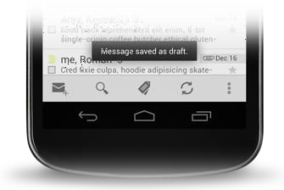
5. Toasts
A toast provides simple feedback about an operation in a small popup.
It only fills the amount of space required for the message and the current activity remains visible and interactive
Toasts automatically disappear after a timeout.

Slide 30
Toasts (con…)
First, instantiate a Toast object with one of the makeText() methods.
This method takes three parameters: the application Context, the text message, and the duration for the toast. It returns a properly initialized Toast object.
You can display the toast notification with show().

Slide 31
Toasts (con…)
Context context = getApplicationContext(); CharSequence text = "Hello toast!";
int duration = Toast.LENGTH_SHORT;
Toast toast = Toast.makeText(context, text, duration); toast.show();
(or)
Toast.makeText(context, text, duration).show(); (or)
Toast.makeText(getApplicationContext(),”Hello toast!”, Toast.LENGTH_“HORT).show();

Slide 32
Positioning your Toast
A standard toast notification appears near the bottom of the screen, centered horizontally.
You can change this position with the setGravity(int, int, int) method.
This accepts three parameters: a Gravity constant, an x-position offset, and a y-position offset.
Exmaple toast.setGravity(Gravity.TOP|Gravity.LEFT, 0, 0);

Slide 33
6. Displaying Dialog Window
A dialog is a small window that prompts the user to make a decision or enter additional information.
Creating alert dialog is very easy.
The Dialog class is the base class for dialogs, but you should avoid instantiating Dialog directly.
Instead, use one of the following subclass AlertDialog class

Slide 34
Dialog Window (con…)
Three regions of an alert dialog
Title
This is optional and should be used only when the content area is occupied by a detailed message.
Content area
This can display a message.
Action buttons
There should be no more than three action buttons in a dialog.

Slide 35
Dialog Window (con…)
Different action buttons
Positive
Use this to accept and continue with the action (the "OK" action).
Negative
Use this to cancel the action.
Neutral
Use this when the user may not want to proceed with
the action, but doesn't necessarily want to cancel.
It appears between the positive and negative buttons.
For example, the action might be "Remind me later."

Slide 36
Dialog Window (con…)
Different alert dialogue methods
one button(ok button) - setPositiveButton()
two buttons(yes or no buttons) - setNegativeButton()
three buttons(yes, no and cancel buttons) - setNeutralButton()

Slide 37
Example
AlertDialog.Builder alertDialog = new AlertDialog.Builder(AlertDialogActivity.this);
// Setting Dialog Title alertDialog.setTitle("Confirm Delete...");
// Setting Dialog Message
alertDialog.setMessage("Are you sure you want delete this?");
// Setting Icon to Dialog
alertDialog.setIcon(R.drawable.delete);

Slide 38
Example (con…)
// Setting Positive "Yes" Button alertDialog.setPositiveButton("YES", new
DialogInterface.OnClickListener() {
public void onClick(DialogInterface dialog,int which) {
// Write your code here to invoke YES event Toast.makeText(getApplicationContext(), "You
clicked on YES", Toast.LENGTH_SHORT).show();
}
});

Slide 39
Example (con…)
// Setting Negative "NO" Button alertDialog.setNegativeButton("NO", new
DialogInterface.OnClickListener() {
public void onClick(DialogInterface dialog, int which) {
// Write your code here to invoke NO event Toast.makeText(getApplicationContext(), "You clicked
on NO", Toast.LENGTH_SHORT).show();
dialog.cancel();
}
});

Slide 40
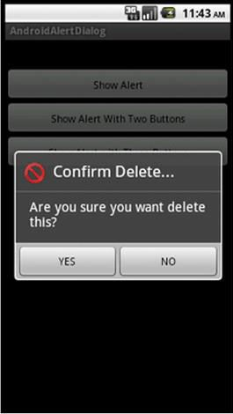
Output
// Showing Alert Message alertDialog.show();

Slide 41
7. Notification
A notification is a message you can display to the user outside of your application's normal UI.
When you tell the system to issue a notification, it first appears as an icon in the notification area.
To see the details of the notification, the user opens
the notification drawer.
Both the notification area and the notification drawer are system-controlled areas that the user can view at any time.
Android Toast class provides a handy way to show users alerts but problem is that these alerts are not persistent which means alert flashes on the screen for a few seconds and then disappears.

Slide 42
Step 1 - Create Notification Builder
A first step is to create a notification builder using NotificationCompat.Builder.
It provides a builder interface to create an notification object.
Use Notification Builder to set various Notification properties like its small and large icons, title, priority etc.
Syntax
NotificationCompat.Builder mBuilder = new NotificationCompat.Builder(this);

Slide 43
Step 2 - Setting Notification Properties
To set its Notification properties using Builder object as per your requirement.
A small icon, set by setSmallIcon()
A title, set by setContentTitle()
Detail text, set by setContentText()
Example mBuilder.setSmallIcon(R.drawable.notification_icon); mBuilder.setContentTitle("Notification Alert, Click Me!");
mBuilder.setContentText("Hi, This is Android Notification Detail!");

Slide 44
Notifications in Android are represented by the Notification class.
To create notification, Use NotificationManager class which can be received from the Context, eg. an activity or a service, via getSystemService() method.
Context.getSystemService() method is used when we want to access one of Android system level services.
To name only few of managers that we can get:
LocationManager – access GPS device information
NotificationManager – manage (create, cancel) notifications
ConnectivityManager – access network connection details and manage those connections

Slide 45
Step 4 - Issue the notification
Finally, you pass the Notification object to the system by calling mNotificationManager.notify() to send your notification.
Make sure you call
mBuilder.build() method on builder object before notifying it.
Example
NotificationManager mNotificationManager = (NotificationManager) getSystemService(Context.NOTIFICATION_SERVICE)
mNotificationManager.notify(notificationID, mBuilder.build());
To make the notification appear, call mNotificationManager.notify(), passing it a unique ID for the notification and the result of mBuilder.build()

Slide 46
Example
Button b; b=(Button)findViewById(R.id.notify_btn);
b.setOnClickListener(new View.OnClickListener() {
@Override
public void onClick(View v) {
// TODO Auto-generated method stub Notify_method("Test notify message");
}

Slide 47
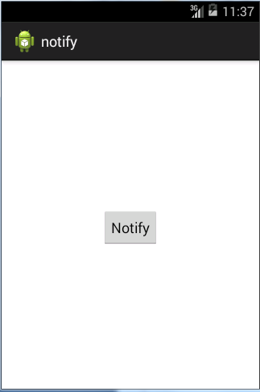
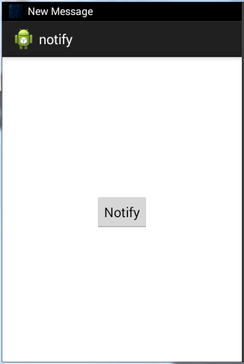
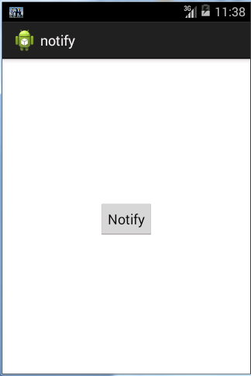
Output

Slide 48
8. Services
A service is a component that runs in the background to perform long-running operations without needing to interact with the user and it works even if application is destroyed.
A service can essentially take two states
Started
A service is started when an application component, such as an activity, starts it by calling startService().
Once started, a service can run in the background indefinitely, even if the component that started it is destroyed.

Slide 49
“Services (con…)
Bound
A service is bound when an application component binds to it by calling bindService().
A bound service offers a client-server interface that allows
components to interact with the
service, send requests, get
results, and even do so across processes with inter-process
communication (IPC).
A service has life cycle callback methods that you can implement to monitor changes in the service's state and you can perform work at the appropriate stage

Slide 50
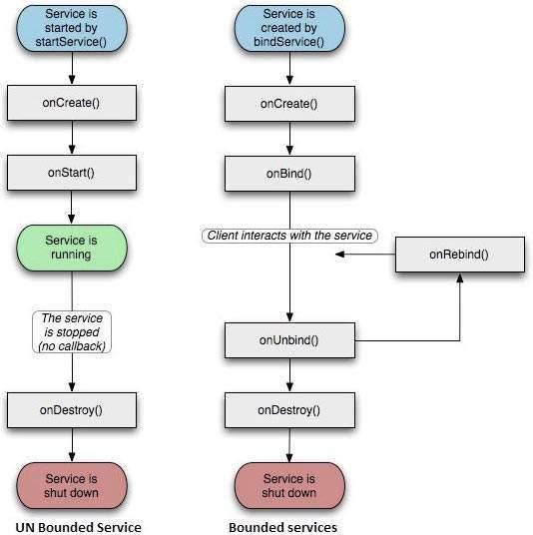
Service Life Cycle

Slide 51
“Services (con…)
To create an service, you create a Java class that extends the Service base class or one of its existing subclasses.
The Service base class defines various callback methods and the most important are given below.
Don't need to implement all the callbacks methods

Slide 52
“Services (con…)
onStartCommand()
The system calls this method when another component, such as an activity, requests that the service be started, by calling startService().
If you implement this method, it is your responsibility to stop the service when its work is done, by calling stopSelf() or stopService()methods.
onBind()
– The system
calls component wants to
this method when another
bind with the service by
calling bindService()

Slide 53
“Services (con…)
onUnbind()
The system calls this method when all clients have disconnected from a particular interface published by the service.
onRebind()
The system calls this method when new clients have connected to the service, after it had previously been notified that all had disconnected in its onUnbind(Intent).

Slide 54
“Services (con…)
onCreate()
The system calls this method when the service is first created using onStartCommand() or onBind(). This call is required to perform one-time set-up.
onDestroy()
The system calls this method when the service is no longer used and is being destroyed.
Your service should implement this to clean up any resources such as threads, registered listeners, receivers, etc.

Slide 55
Declaring a service in the manifest
Like activities (and other components), you must declare all services in your application's manifest file.
To declare your service, add a <service> element as a child of the <application> element.
Example
<manifest ... >
...
<application ... >
<service android:name=“com.example.service.MyService” />
...
</application>
</manifest>

Slide 56
Example
public class MainActivity extends Activity { @Override
Private Button bstart,bstop;
public void onCreate(Bundle savedInstanceState) { super.onCreate(savedInstanceState); setContentView(R.layout.activity_main);
bstart=(Button)findViewById(R.id.button1);
bstop=(Button)findViewById(R.id.button2);
bstart.setOnClickListener(this);
bstop.setOnClickListener(this);

Slide 57
Intent serviceIntent=new Intent(getApplicationContext(),MyService.class);
} }
public void onClick(View view)
{
If(view==bstart){
startService(serviceIntent);}
else if(view==bstop){
stopService(serviceIntent);}
}
}

Slide 58
XML file
<Button
android:layout_width="wrap_content" android:layout_height="wrap_content"
android:id="@+id/button1" android:text="START SERVICES" android:onClick="startService“ />
<Button
android:layout_width="wrap_content" android:layout_height="wrap_content" android:text="STOP SERVICES"
android:id="@+id/button2" android:onClick="stopService“ />

Slide 59
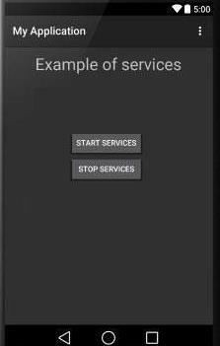
Output

Slide 60
Example
public class MyService extends Service {
private MediaPlayer player;
@Override
public IBinder onBind(Intent arg0) {
// TODO Auto-generated method stub
return null;
}
public int onStartCommand(Intent i,int flag,int startId)
{
player=MediaPlayer.create(getApplicationContext(), Settings.System.DEFAULT_ALARM_ALERT_URI);
player.setLooping(true);
player.start();
return startId;
}
public void onDestroy()
{
super.onDestroy();
player.stop();
}
}

Slide 61
9. Broadcast Receivers
Simply respond to broadcast messages from other applications or from the system itself.
These broadcasts are sent when an event occurs.
For Example, Android system sends Broadcasts, when various events occurs such as when the system boots up, Device starts charging.
Broadcast receiver who will intercept this communication and will initiate appropriate action.
Three important steps
Creating the Broadcast Receiver.
Registering Broadcast Receiver
Broadcasting Custom Intents

Slide 62
Creating the Broadcast Receiver
A broadcast receiver is implemented as a subclass
of BroadcastReceiver class and overriding the onReceive() method where each message is received as a Intent object parameter.
Example
public class MyReceiver extends BroadcastReceiver { @Override
//onReceive() is executed when Broadcast receiver is triggered
public void onReceive(Context context, Intent intent) {
If(Intent.ACTION_BOOT_COMPLETED.equals(intent.getAction())){
Toast.makeText(context, "Boot Completed", Toast.LENGTH_LONG).show();
} }
•

Slide 63
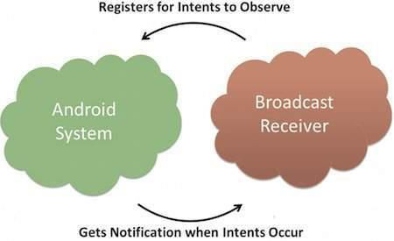
Registering Broadcast Receiver
An application listens for specific broadcast intents by registering a broadcast receiver in AndroidManifest.xml file.
Consider we are going to register MyReceiver for system generated event ACTION_BOOT_COMPLETED which is fired by the system once the Android system has completed the boot process.

Slide 64
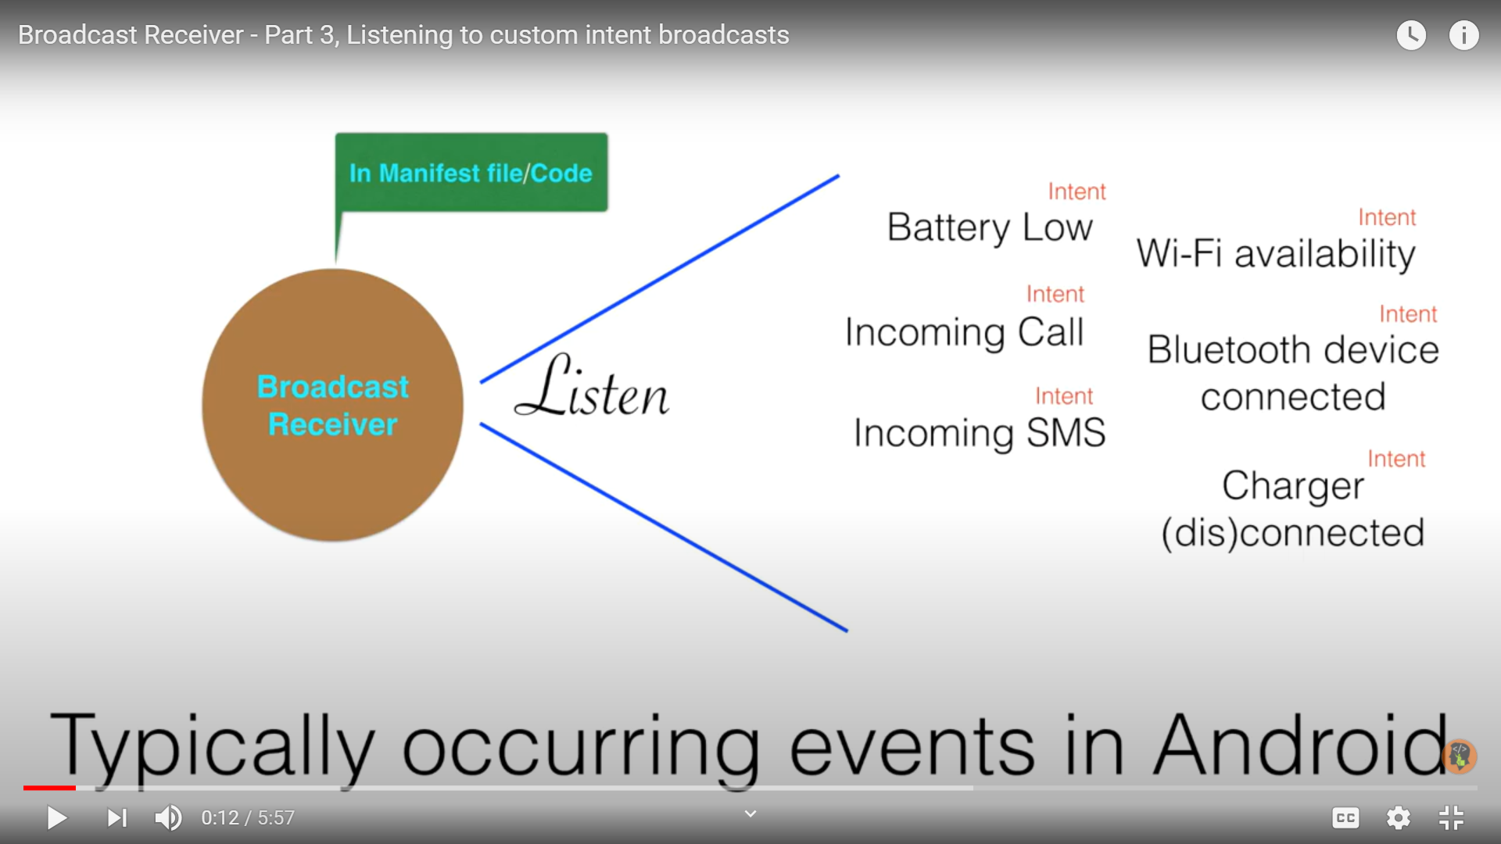
Broadcast receiver respond to multiple System generated intent broadcast

Slide 65
…Broadcast Receiver (con…)
To modify in AndroidManifest.xml file
<receiver android:name="MyReceiver">
<intent-filter>
<action android:name="android.intent.action.BOOT_COMPL ETED">
</action>
</intent-filter>
</receiver>

Slide 66
Few important system events
Event Constant | Description
android.intent.action.BATTERY_CHANGED | Containing the charging state, level, and other information
android.intent.action.BATTERY_LOW | Indicates low battery condition
android.intent.action.BATTERY_OKAY | Indicates the battery is now okay after being low.
android.intent.action.BOOT_COMPLETED | After the system has finished booting.
android.intent.action.BUG_REPORT | Show activity for reporting a bug.
android.intent.action.CALL | Perform a call to someone specified by the data.
android.intent.action.CALL_BUTTON | The user pressed the "call" button to go to the dialer
android.intent.action.DATE_CHANGED | The date has changed.
android.intent.action.REBOOT | Have the device reboot. 70

Slide 67
Broadcasting Custom Intents
If you want your application itself should generate and send custom intents then you will have to create and send those intents by using the sendBroadcast() method inside your activity class.
To modify the AndroidManifest.xml file
<receiver android:name="MyReceiver">
<intent-filter>
<action
android:name="com.example.CUSTOM_INTENT">
</action>
</intent-filter>
</receiver>
67

Slide 68
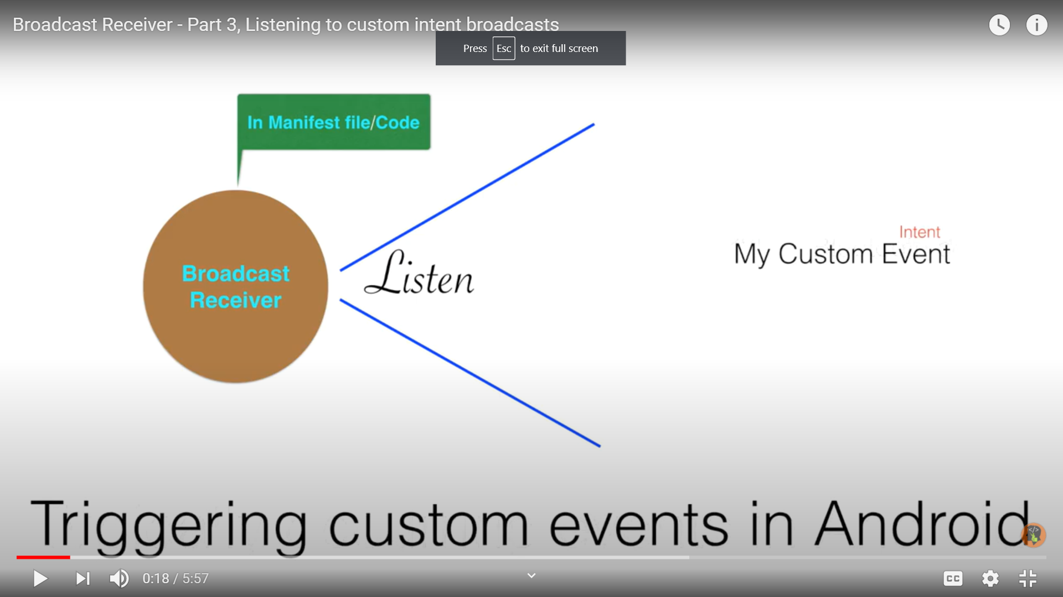
Broadcast receiver respond to custom generated intent broadcast

Slide 69
Example
public class MainActivity extends Activity {
@Override public void onCreate(Bundle savedInstanceState) { super.onCreate(savedInstanceState); setContentView(R.layout.activity_main);
}
// broadcast a custom intent.
public void broadcastIntent(View view){ Intent intent = new Intent();
intent.setAction("com.example.CUSTOM_INTENT");
sendBroadcast(intent);
} }
69

Slide 70
Example (Overall) (con…)
public class MyReceiver extends BroadcastReceiver {
@Override public void onReceive(Context context, Intent intent) { Toast.makeText(context, "Intent Detected.", Toast.LENGTH_LONG).show();
} }
70

Slide 71
AndroidManifest.xml
<receiver android:name="MyReceiver">
<intent-filter>
<action android:name="com.example.CUSTOM_INTEN T">
</action>
</intent-filter>
</receiver>
71

Slide 72
XML File
<TextView android:id="@+id/textView1"
android:layout_width="wrap_content" android:layout_height="wrap_content" android:text="Example of Broadcast“ />
<Button
android:layout_width="wrap_content" android:layout_height="wrap_content" android:id="@+id/button1"
android:text="BROADCAST INTENT"
android:onClick="broadcastIntent“ />
72

Slide 73
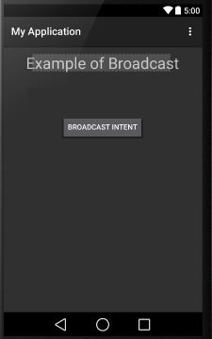
Output
73

Slide 74
10. Content Provider
A content provider manages access to a central repository of data.
A provider is part of an Android application, which often provides its own UI for working with the data.
A content provider component supplies data from one application to others on request.
Such requests are handled by the methods of the ContentResolver class.
A content provider can use different ways to store its data and the data can be stored in a database, in files, or even over a network
74

Slide 75
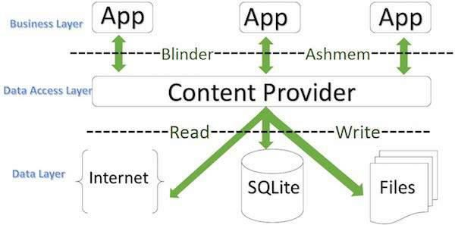
Content Provider (con…)
75

Slide 76
Content Provider (con…)
Sometimes it is required to share data across applications. This is where content providers become very useful.
Content providers let you centralize content in one place and have many different applications access it as needed.
A content provider behaves very much like a database where you can query it, edit its content, as well as add or delete content using insert(), update(), delete(), and query() methods.
76

Slide 77
Create Content Provider
First of all you need to create a Content Provider class that extends the ContentProvider baseclass.
Second, you need to define your content provider URI address which will be used to access the content.
Next you will need to create your own database to keep the content.
Next you will have to implement Content Provider queries to perform different database specific operations.
Finally register your Content Provider in your activity file using <provider> tag.
77

Slide 78
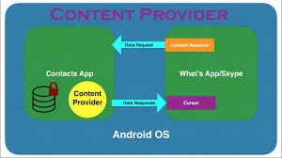
Content Provider

Slide 79
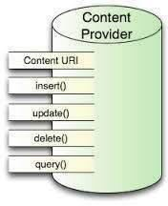
Content Provider (con…)
Syntax:
public class MyApplication extends ContentProvider {
//To do the code here
}
79

Slide 80
Content Provider (con…)
onCreate() This method is called when the provider is started.
query() This method receives a request from a client. The result is returned as a Cursor object.
insert()This method inserts a new record into the content provider.
delete() This method deletes an existing record from the content provider.
update() This method updates an existing record from the
content provider.
getType() This method returns the MIME type of the data at the given URI.
80

Slide 81
AndroidManifest.xml file.
<provider android:name="StudentsProvider" >
<android:authorities="com.example.provider. College">
</provider>
81

Slide 82
Example
public void onClickAddName(View view) {
// Add a new student record
ContentValues values = new ContentValues(); values.put(StudentsProvider.NAME,
((EditText)findViewById(R.id.txtName)).getText().toString());
values.put(StudentsProvider.GRADE, ((EditText)findViewById(R.id.txtGrade)).getText().toString());
Uri uri = getContentResolver().insert(
StudentsProvider.CONTENT_URI, values);
Toast.makeText(getBaseContext(), uri.toString(), Toast.LENGTH_LONG).show(); }
82

Slide 83
Example (con..)
public void onClickRetrieveStudents(View view) {
// Retrieve student records String URL = "content://com.example.provider.College/students";
Uri students = Uri.parse(URL);
Cursor c = managedQuery(students, null, null, null, "name");
if (c.moveToFirst()) {
do{ Toast.makeText(this, c.getString(c.getColumnIndex(StudentsProvider._ID)) + ", " + c.getString(c.getColumnIndex( StudentsProvider.NAME)) + ", "
+ c.getString(c.getColumnIndex( StudentsProvider.GRADE)), Toast.LENGTH_SHORT).show();
} while (c.moveToNext()); }
83

Slide 84
XML file
<Button android:layout_width="wrap_content" android:layout_height="wrap_content" android:id="@+id/button1"
android:text="Add Name“
android:onClick="onClickAddName"/>
<Button android:layout_width="wrap_content" android:layout_height="wrap_content"
android:text="Retrive student"
android:id="@+id/button2“
android:onClick="onClickRetrieveStudents"/>
84

Slide 85
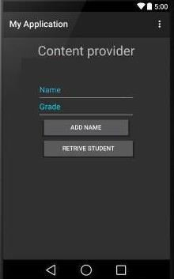
Output
85

Slide 86
11. Databases - SQLite
implementation with simple API
SQLite is the most used database engine in the world
In contrast to many other database management systems, SQLite is not a client–server database engine. Rather, it is embedded into the end program
SQLite is at the heart of Android’s database
support.
Simple, small, light weight RDMS
86

Slide 87
“SQLite (con…)
SQLite is so dominant in the embedded and also the mobile world due to,
Low memory consumption
Ease of use
Free availability
Open Source
ACID Compliant
Uses SQL query language
87

Slide 88
“SQLite (con…)
It differs in many aspects from a conventional database system.
SQLite is serverless
SQLite stores data in one database file
SQLite offers only a few data types
SQLite uses manifest typing instead of static types
SQLite has no fixed column length
SQLite uses cross-platform database files i.eA database that is created on one machine can be copied and used on a different machine with a different architecture)
88

Slide 89
Data Types in SQLite
NULL – The null value
INTEGER - Any number which is no floating point number
REAL - A floating point value, 8-byte IEEE floating point number.
TEXT - text string and also single characters, stored using the database encoding (UTF-8, UTF- 16BE or UTF-16LE).
BLOB(binary large object)- The value is a blob of data, stored exactly as it was input i.e) collection of binary data stored as a value in the database
89

Slide 90
SQLite Classes
SQLiteCursor - A
Cursor implementation that from a query on a
exposes results
SQLiteDatabase.
SQLiteDatabase - Exposes methods to manage a SQLite database. It has methods to create, delete, execute SQL commands, and perform other common database management tasks.
SQLiteOpenHelper - A helper class to manage database creation and version management.
SQLiteProgram - A base class for compiled SQLite programs.
90

Slide 91
“QLite Classes (con…)
SQLiteQuery – A SQLite program that represents a query that reads the resulting rows into a CursorWindow.
SQLiteQueryBuilder - A convenience class that helps build SQL queries to be sent to SQLiteDatabase objects.
SQLiteStatement - A pre-compiled statement against a SQLiteDatabase that can be reused.
91

Slide 92
android.database.sqlite.SQLiteDatabase
Contains the methods for:
creating
opening
closing
inserting
updating
deleting
querying
92

Slide 93
openOrCreateDatabase()
This method will open an existing database or create one in the application data area
SQLiteDatabase myDatabase; myDatabase = openOrCreateDatabase
("my_sqlite_database.db" , Context.MODE_PRIVATE, null);
93

Slide 94
Create Table
String createTable = "CREAT TABLE
contact(id INTEGER PRIMARY KEY
AUTOINCREMENT,
firstName TEXT, lastName TEXT); myDatabase.execSQL(createTable);
94

Slide 95
Insert Records
private void insertContact()
{
SQLiteDatabase database = openOrCreateDatabase("contacts.db", Context.MODE_PRIVATE, null);
ContentValues values = new ContentValues(); values.put("first_name", etFirstName.getText().toString()); values.put("last_name", etLastName.getText().toString()); values.put("phone", etPhone.getText().toString()); values.put("email", etEmail.getText().toString()); database.insert("Contact", null, values);
database.close();
}
95

Slide 96
Update Records
private void updateContact()
{ SQLiteDatabase database = openOrCreateDatabase("contacts.db", Context.MODE_PRIVATE, null);
ContentValues values = new ContentValues(); values.put("first_name", etFirstName.getText().toString()); values.put("last_name", etLastName.getText().toString()); values.put("phone", etPhone.getText().toString()); values.put("email", etEmail.getText().toString()); database.update("Contact", values, "phone = ?", new String[]{contact.getPhone()});
database.close();
}
96

Slide 97
Record Deletion
int delete(String table, String whereClause,
String[] whereArgs)
String [] whereArgs= {"20", "30"}; recAffected= myDatabase.delete(“contact",
"recID> ? and recID< ?", whereArgs);
97

Slide 98
Queries using SQLite
Android offers two mechanisms for phrasing SQL-select statements:
Raw queries take for input a syntactically correct SQL-select statement. The select query could be as complex as needed and involve any number of tables
Simple queries are compact parameterized select statements that operate on a single table
98

Slide 99
Raw Query
Cursor c1 = db.rawQuery("select count(*)
as Total from demo",null);
String mySQL= "select count(*) as Total
from demo where recID> ? and name = ?"; String[] args= {"1", "Sathyabama"};
Cursor c1 = db.rawQuery(mySQL, args);
99

Slide 100
Simple Queries
Simple queries use a template implicitly representing a condensed version of a typical (non-joining) SQL select statement.
No explicit SQL statement is made.
Simple queries can only retrieve data from a single table.
100

Slide 101
“imple Queries (con…)
The method’s signature has a fixed sequence of seven arguments representing:
the table name
the columns to be retrieved
the search condition (where-clause)
arguments for the where-clause
the group-by clause
having-clause
the order-by clause
101

Slide 102
query method
query(String table, String[] columns, String selection,
String[] selectionArgs, String groupBy,
String having, String orderBy)
102

Slide 103
Simple Query - Example
String[] columns = {"Dno","Avg(Salary) as AVG"}; String[] conditionArgs= {"30", "Chennai"}; Cursor c = db.query("EmployeeTable",
columns,
" age>= ? And location= ? " , conditionArgs,
"Dno", "Count(*) > 2",
"AVG Desc " );
103

Slide 104
Cursors
Android cursors are used to gain (random) access to tables produced by SQL select statements.
Cursors primarily provide one row-at-the-time operations on a table.
Positional awareness operators (isFirst(), isLast(),
isBeforeFirst(), isAfterLast())
Record Navigation (moveToFirst(), moveToLast(),
moveToNext(), moveToPrevious(), move(n))
Field extraction (getInt, getString, getFloat, getBlob, getDate)
Schema inspection (getColumnName, getColumnNames, getColumnIndex, getColumnCount, getCount)
104

Slide 105
Cursor Example
String [] columns ={"id", "firstname", "lastname"};
Cursor myCur= db.query("demo", columns, null, null, null, null, "recID");
int idCol= myCur.getColumnIndex("id");
int fnameCol= myCur.getColumnIndex("firstname"); int lnameCol= myCur.getColumnIndex("lastname"); while(myCur.moveToNext()) {
columns[0] = Integer.toString((myCur.getInt(idCol))); columns[1] = myCur.getString(fnameCol); columns[2] = myCur.getString(lnameCol);
txtMsg.append("\n"+ columns[0] + " " + columns[1] + " " +
columns[2] );
105

Slide 106
12. Publish App in Playstore
In order to publish applications on Google play, it is necessary to have a publisher account. To sign up for a publisher account follow these steps:
1. Visit the Google Play Android Developer console at https://play.google.com/apps/publish.
2. Enter basic information about your developer identity.
3. Read and accept the Developer Distribution Agreement for your locale.
4. Pay the $25 USD registration fee.
5. Confirm verification by e-mail.
6. After the account has been created, it is possible to publish applications using Google Play.
106

Slide 107
Publish App in Playstore (con…)
Android application publishing is a process that makes your Android applications available to users.
Infect, publishing is the last phase of the Android application development process.
Once you developed and fully tested your Android Application, you can start selling or distributing free using Google Play.
You can also release your applications by sending them directly to users or by letting users download them from your own website.
107

Slide 108
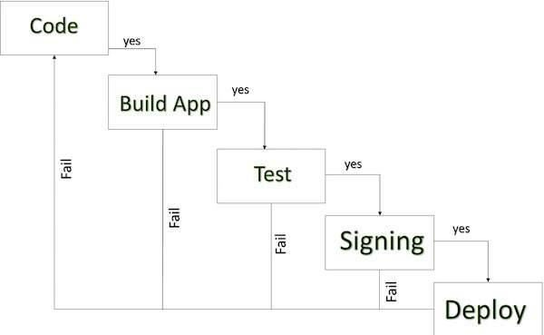
Publish App in Playstore (con…)
108

Slide 109
Publish App in Playstore (con…)
A simplified check list which will help you in launching your Android application.
1. Regression Testing Before you publish your application, you need to make sure that its meeting the basic quality expectations for all Android apps, on all of the devices that you are targeting. So perform all the required testing on different devices including phone and tablets.
2. Application Rating When you will publish your application at Google Play, you will have to specify a content rating for your app, which informs Google Play users of its maturity level. Currently available ratings are
Everyone (b) Low maturity (c) Medium maturity (d) High maturity.
109

Slide 110
Publish App in Playstore (con…)
3. Targeted Regions Google Play lets you control what countries and territories where your application will be sold. Accordingly you must take care of setting up time zone, localization or any other specific requirement as per the targeted region.
4. Application Size Currently, the maximum size for an APK published on Google Play is 50 MB. If your app exceeds that size, or if you want to offer a secondary download, you can use APK Expansion Files, which Google Play will host for free on its server infrastructure and automatically handle the download to devices.
110

Slide 111
Publish App in Playstore (con…)
5. SDK and Screen Compatibility It is important to make sure that your app is designed to run properly on the Android platform versions and device screen sizes that you want to target.
6. Application Pricing Deciding whether your app will be free or paid is important because, on Google Play, free app's must remain free. If you want to sell your application then you will have to specify its price in different currencies.
111

Slide 112
Publish App in Playstore (con…)
7. Promotional Content It is a good marketing practice to supply a variety of high-quality graphic assets to showcase your app or brand. After you publish, these appear on your product details page, in store listings and search results, and elsewhere.
8. Build and Upload release-ready APK The release-ready APK is what you will upload to the Developer Console and distribute to users. You can check complete detail on how to create a release-ready version of your app: Preparing for Release
112

Slide 113
Publish App in Playstore (con…)
– 9. Finalize Application Detail Google Play gives you a variety of ways to promote your app and engage with users on your product details page, from colour-ful graphics, screen shots, and videos to localized descriptions, release details, and links to your other apps. So you can decorate your application page and provide as much as clear crisp detail you can provide.
113

Slide 114
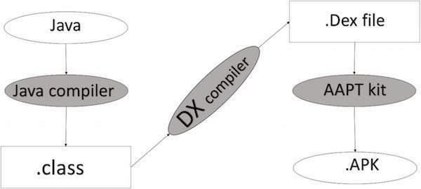
Publish App in Playstore (con…)
APK DEVELOPMENT PROCESS
114

Slide 115
Publish App in Playstore (con…)
Before exporting the apps, you must know some of the tools
Dx tools(Dalvik executable tools ): It going to convert .class file to .dex file. it has useful for memory optimization and reduce the boot-up speed time
AAPT(Android assistance packaging tool): It has useful to convert .Dex file to .apk file
APK(Android packaging kit): The final stage of deployment process is called as .apk.
You will need to export your application as an APK (Android Package) file before you upload it Google Play.
115

Slide 116
Publish App in Playstore (con…)
To export an application, just open that application
project in Eclipse IDE / Android select Build → Generate Signed APK
studio and from your
Eclipse IDE / Android studio and follow the simple steps to export your application.
Next select, Generate Signed APK option as shown in the above screen shot and then click it so that you get following screen where you will choose Create new keystore to store your application.
116

Slide 117
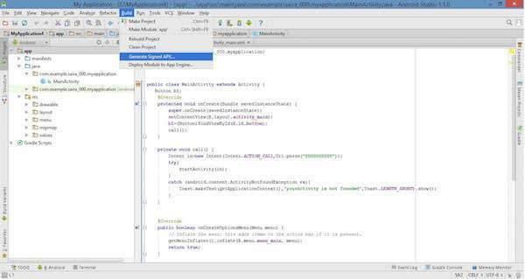
Publish App in Playstore (con…)
117

Slide 118
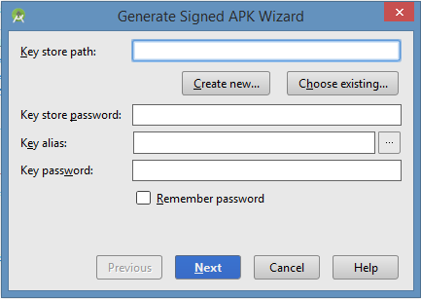
Publish App in Playstore (con…)
118

Slide 119
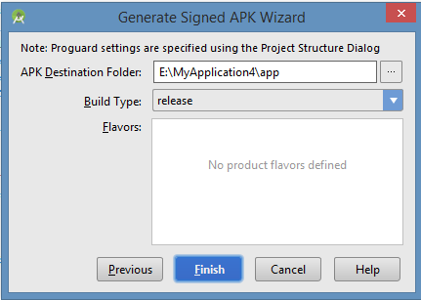
Publish App in Playstore (con…)
Enter your key store path, key store password, key alias and key password to protect your application and click on Next button once again. It will display following screen to let you create an application:
119

Slide 120
Publish App in Playstore (con…)
Once you filled destination,
up all the information, like app build type and flavours
click finish button While creating an application it will show as below
Finally, it will generate your Android Application as APK format File which will be uploaded at Google Play marketplace.
120

Slide 121
13. Sample Applications
To develop an App for sending data from one activity to another
To develop an App for web browser
To develop an App for sending SMS
To develop an App for Placement Registration
To develop an App for Resume
To develop an App for phone profile changer
To develop an App for sending notifications
121

